Slide 1


作業系統 Operating Systems
靜宜大學資訊傳播工程學系
劉國有 助理教授
kyliu@pu.edu.tw
❑ 記憶體未抽象化的電腦運作

Slide 2
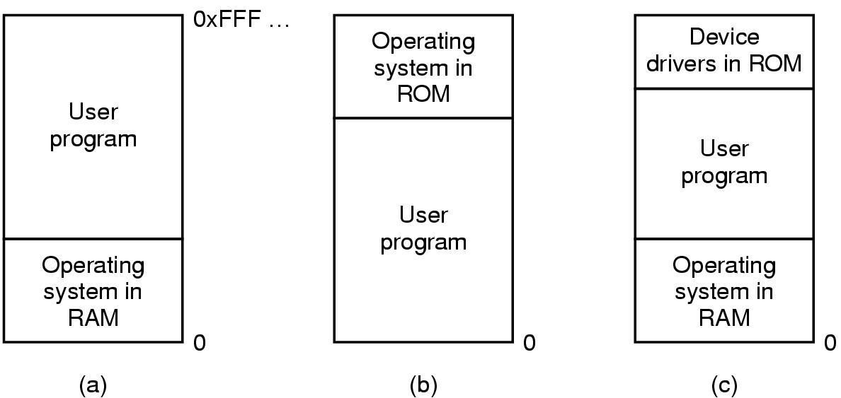
No Memory Abstraction: Uni-program Computer
Every program simply saw the physical memory
Mainframes/
minicomputers
PDAs/
Embedded systems
Early personal
computers

Slide 3
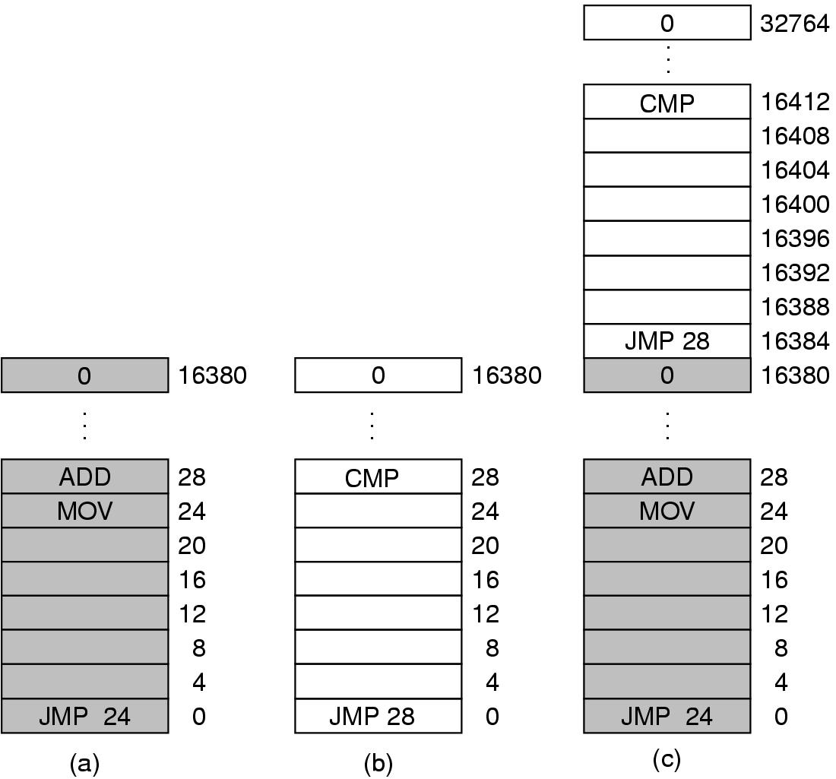
No Memory Abstraction: Multi-program Computer
Static relocation: when a program was loaded at address addr, the constant addr was added to every program address during the loading of process.
Static relocation refers to address transformations being done before execution of a program begins.

